Slide 1

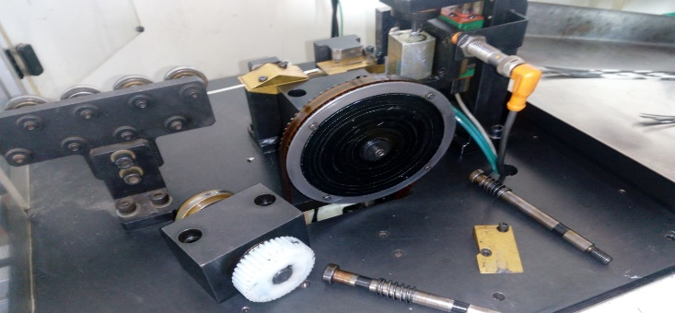
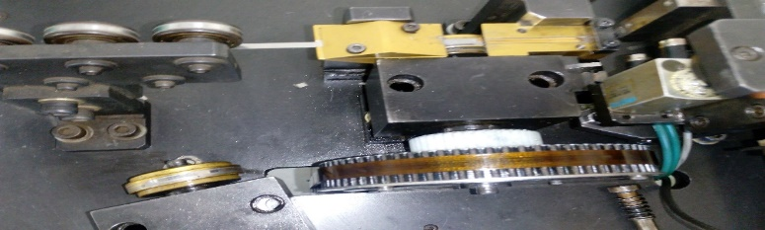
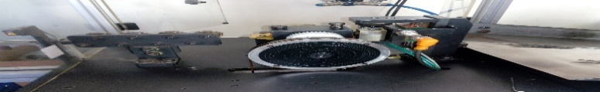
P15
TPM CIRCLE NO :- 01
ACTIVITY
KK
QM
PM
JH
SHE
OT
DM
E&T
KAIZEN IDEA SHEET
TPM CIRCLE NAME: Achiever
LOSS NO. / STEP
DEPT :- Assembly
RESULT AREA
P
Q
A
B
C
D
S
M
CELL : Spring annea
CELL NAME: Tensioner
MACHINE / STAGE Spring Annealing
OPERATION
KAIZEN THEME : To reduce set up time and improve productivity
IDEA : To increases plate depth (spring holding plate)
PROBLEM PRESENT STATUS: more time required for spring loading on machine every roll loading time
COUNTERMEASURE:- Increases spring depth 1.14 mm to 0.17 so that spring roll loading possible without dismantling the fixture
BENCHMARK
TARGET
Plate depth 0.14 mm
Plate depth 0.20 mm
KAIZEN START
2.1.2017
:
TDC
2.1.2017
KAIZEN FINISH
4.1.2017
TEAM MEMBERS: Santosh Salve
BENEFITS :-1) To reduce in house rejection
Before
After
KAIZEN SUSTENANCE
WHY - WHY ANALYSIS :-
Why1 : more time required for spring roll loading on machine
Why2: needs of dismantling fixture
Why3: All nut ,bolts and plate loader block looses and dismantling
Why: Without fixture dismantling not possible spring loading
RESULT :-
1) Reduces set up time
2) increases productivity
WHAT TO DO:-Modify fixture
HOW TO DO:
FREQUENCY :-
SCOPE & PLAN FOR HORIZONTAL DEPLOYMENT
Sr No | CELL | TDC | RESP. | STATUS
1
2
ROOT CAUSE : Spring loading on machine not possible without dismantling the fixture
REGISTRATION NO. & DATE: 4.1.2017
REGISTERED BY: Santosh Salve
MANAGER’S SIGN :- Janardhan sathe

